Slide 1
Computer Algorithm
Chapter I. Introduction

Slide 2
Definition of algorithm
Algorithm is the sequence of instructions whichare involved in solving a given problem
Or accomplishment of a given task. It can be translated into a programming language in order to produce the result.

Slide 3
Structure of an algorithm
An algorithm is made mainly of the following parts:
The variable declaration line
The beginning of an algorithm
The instructions part
The end

Slide 4
Example:
Var A as Integer
Start
A←5
End

Slide 5
Explanations:
Var A as Integer is the variable declaration line
Start marks the beginning of an algorithm
A←5 the instructions part
End marks the end of an algorithm

Slide 6
Variables
A variable is a memory zone which is used to store data. It is characterized by a name, an
Address and a data type.
Variable name: a variable name helps to distinguish it from other variables,
Variable address: helps to locate it in the memory,
Variable data type: helps to know the operations allowed to be performed on it
And the size it occupies in the memory

Slide 7
Variable declaration
A variable to be used must first be declared. Declare a variable; means create it by giving
it a name and a data type.

Slide 8
Rules for giving a valid name to a variable
Start a variable name with a upper case letter
Don’t use a blank space in variable name
Instead of using a blank space in a variable name put underscore
Don’t use reserved words
Don’t use special characters

Slide 9
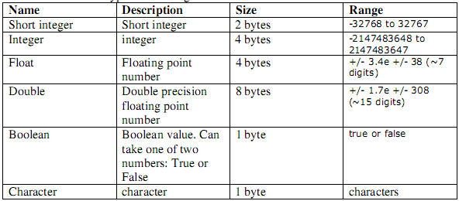
Data type in algorithm
Here are some data types used in algorithm

Slide 10
Operators in algorithm
A). Arithmetic operators
+ Addition
- Subtraction
* Multiplication
/ Division
↑ or Power

Slide 11
Operators in algorithm
B). Comparison operators
> Greater than
< Less than
>= Greater than or equal to
<= Less than or equal to
= Equal to
!= Not equal to

Slide 12
Operators in algorithm
C). Logic operators
AND operator
OR operator
D). Assignment operator
To put a value in a variable we use an assignment operator which has the following
Symbol: ←

Slide 13
Quiz
1. How would you assign the value 3.14 to a variable called pi?
2. Is it possible to assign an int to a double?
  Is the reverse possible?

